Slide 1
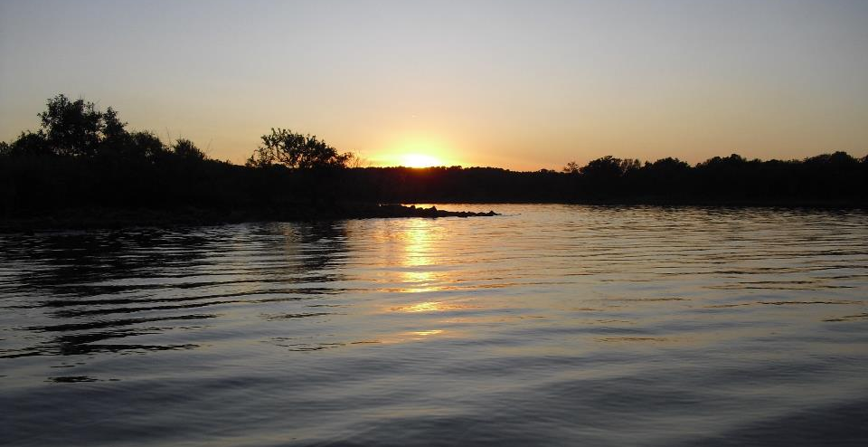
Field Test Kits: Types, Parameters, QA Issues
GCSA Workshop
OKR04 MCM-3 and Part IV Sampling and Field Methods
Presented by INCOG
Nienhuis Park
May 18, 2022

Slide 2
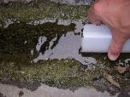

Monitoring versus Sampling
OKR04 does not define either term in Part I (Definitions).
  However, OKR04 text draws a clear distinction between terms.
  “Sampling” used only 3 times; all concern data collected from a single event.
  “Monitoring” used 40 times; all with respect to plans and programs.
Monitoring concerns a data collection project / program wherein sampling provides the project’s data.

Slide 3
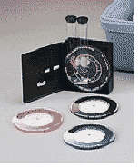

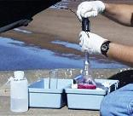
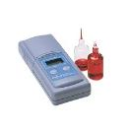
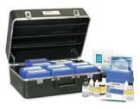
Types of Field Instruments
Comparator Test Kits
Test Strips
These types of kits rely upon chemical reactions to indicate the presence and/or concentration of a specific parameter.
Titrations
Colorimeters
An SOP should be written for each device and procedure.
Multi-Test Kits
No endorsement of products is intended.

Slide 4
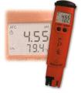
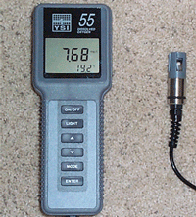



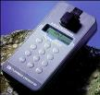



Types of Field Instruments
Test Pens
Single Parameter Meters
Multi-Parameter Meters
These types of kits measure directly the concentration of one or more parameters.
Field Fluorometers
An SOP should be written for each device and procedure.
Flow Meters
No endorsement of products is intended.

Slide 5
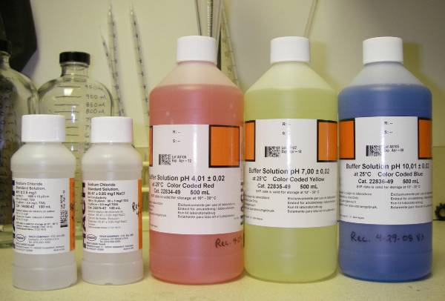
Equipment and Supplies Basics
Maintain all sampling equipment in good operating order.
Properly store all equipment and supplies.
Keep a supply of consumables such as standards and reagents.
Watch expiration dates and replace as needed.
Carry new batteries and spare parts with equipment in the field.
Document in Maintenance Logs every action taken.

Slide 6
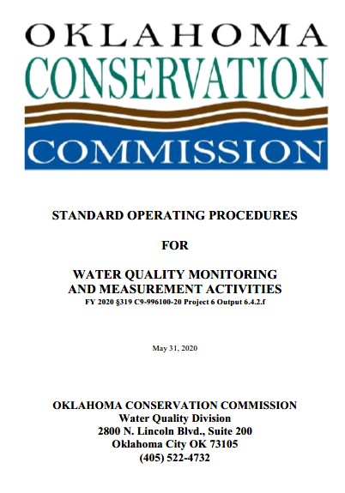
Written Procedures and SOPs
Field work should always be planned well with SOPs or other written procedures:
  Purpose, methods, goals.
  Equipment and supplies needed.
  Training, levels of skill and knowledge.
  Safety of field crews and the public.
  Update SOPs frequently as needed.
Include “Action Levels” for your screening tests: the limits of a test result beyond which is an indication of a pollution problem.
SOP Document Example

Slide 7
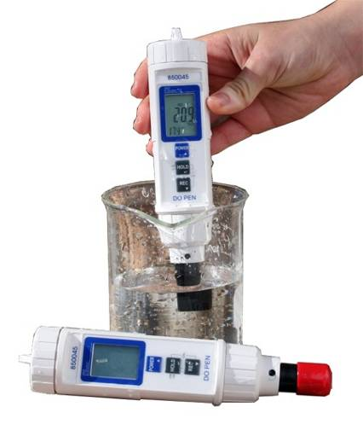
Instrument Calibration
Some instruments require calibration before analysis.
Calibration is the comparison of an instrument reading to the known value of a standard.
Example: Calibration cond. std. = 1,050 uS/cm. Set the instrument to read 1,050.
Use written calibration procedures or SOPs.
Never use expired calibration standards; always store chemicals properly to preserve quality.
Calibration requires adjustments to ensure the instrument is reporting the correct values.
Record all calibration results in a calibration log.

Slide 8
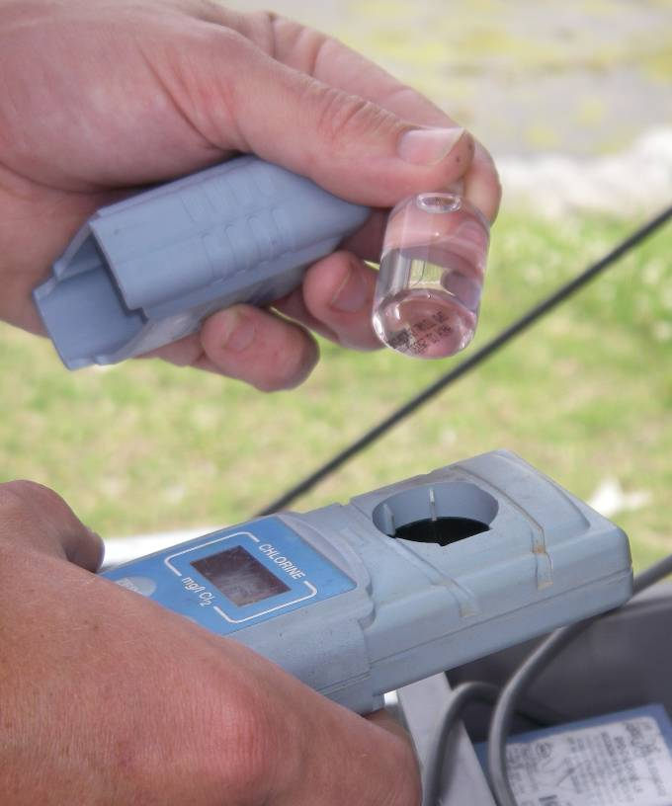
Calibration Practices and Concerns
When to calibrate or verify the calibration:
  each day before use
  when the instrument seems “off calibration”
  after prolonged instrument use (per QAPP)
Causes of “off calibration”:
  Physical - rough handling, temperature changes, dirt or dust, voltage changes, breakdown of mechanical or electrical components.
  Procedural - not following procedures, bad standards, sloppy technique, improper storage, poor knowledge and training.

Slide 9

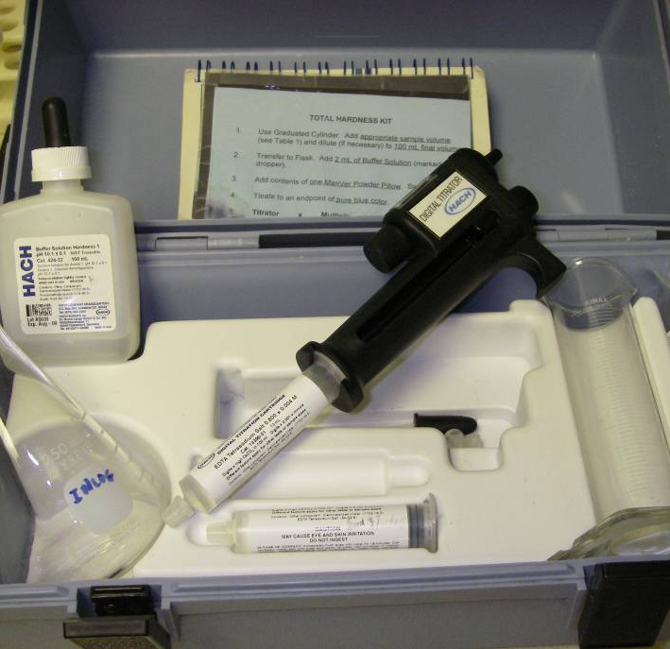
Field Screening Tests vs. Lab Analysis
Data Quality – Some field kits can produce legally defensible data; most cannot (screening only).
Field Screening – Typically used for quick, easy, inexpensive search for “hot spots”.
  Gives fast results and the ability to act quickly before conditions change.
  Most OKR04 investigations will involve visual observations and “simple field test kits”.
Lab Analysis – Used to confirm test kits and for tough enforcement actions requiring court-ready data of defensible quality.

Slide 10
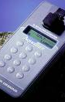
Common Field Test Parameters
Commonly measured parameters in the field include:
pH Conductivity
Temperature Dissolved Oxygen
Flow Chlorine
Hardness Ammonia
Phosphorus Nitrogen, Nitrate
Optical Brighteners Turbidity
MBAS Oil & Grease (visual)
Most test parameters have complex chemistry and can be difficult to interpret. The more you know….

Slide 11
pH (Acidic / Basic)
pH is the “-log of hydrogen ion concentration” (H⁺).
Measure pH in the field; it’s not a lab sample.
pH units are “standard units” (s.u.) on a “log scale”.
The pH of natural surface waters is ~ 7 to 8 s.u.
Pollutant discharges may be much higher or lower. (low pH = acidic, high pH = basic)
The pH scale range is 0-14. (most readings will be between 4 and 9)
Typical pH action levels are those outside the 6.5 to 9.0 range. (require follow-up investigations)

Slide 12
Conductivity
(Specific Conductance)
Conductivity is a measure of the water’s ability to conduct electricity by the presence of ions.
Conductivity goes up as the amount of dissolved solids (ionic salts and minerals) in the water increases.
Conductivity is a good indicator of runoff from industrial sources, oil field activities and road deicing.
All natural waters have dissolved salts, some in high concentrations.
Interpreting conductivity requires that you know your stream’s natural conditions for comparison.

Slide 13
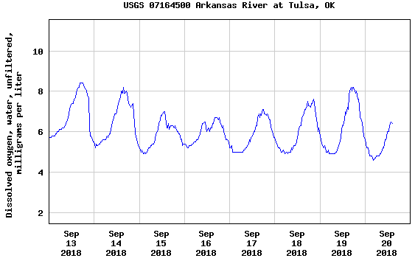
Dissolved Oxygen & Temperature
Of all field parameters, “DO” is probably the most important.
So many types of pollution and physical disturbances affect DO.
DO is also affected by many environmental and sampling conditions.
Data interpretation is difficult and requires much knowledge.
Temperature must also be measured.
DO test kits are difficult to use and costly.
Sampling “representativeness” is crucial.
Example of a DO “Diurnal Cycle”

Slide 14
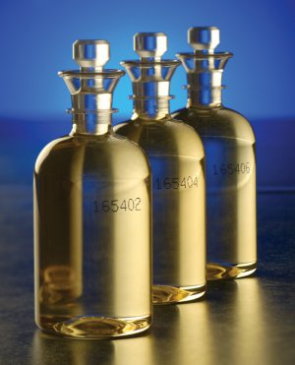
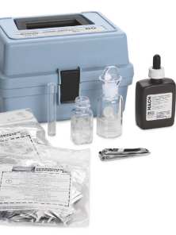
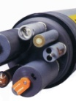
Dissolved Oxygen Test Methods
All field test kits rely upon either chemical reactions or physical properties.
Most common chemistry: Modified Winkler Test:
  “Fix” in the field for lab titration, or
  Field titration, no lab analysis needed.
Most common physical property: DO membrane diffusion: Calibration!
  Single probe instrument.
  Multi-probe instrument (a.k.a. “sonde”)
  Can be left for days, set to read periodically.

Slide 15
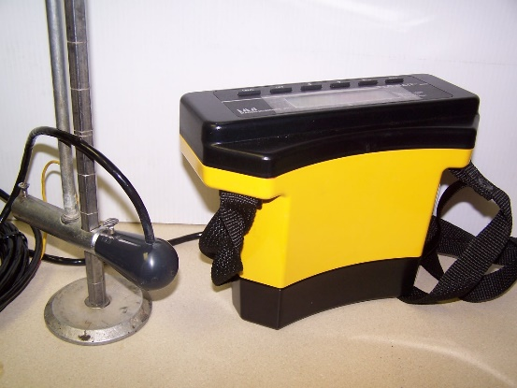
Flow (as Velocity and Discharge)
WQS are set for concentrations, not mass loadings.
TMDL limits are in mass loadings, not concentrations.
Mass Load (lbs/d) = Conc. (mg/L) x Flow (cfs) x 8.34
Flow meters measure Velocity (fps)
Discharge (cfs) = Velocity (fps) x Cross-Sectional Area (ft²)
To Measure or Estimate?
  Estimate Velocity: time to float a stick a specific distance (fps)
  Estimate xSect. Area: visual estimate of average W and D (ft²)
  Measure Velocity: Flow meters (fps)
  Measure xSect. Area: tapes, rulers. Multiple xchannel readings (ft²)
Either way, multiply to calculate Discharge (cfs).
When to use Metric? Verify data uses and data needs (DQOs).

Slide 16

Chlorine Residual
Chlorine vs. Chloride: Same atom, but very different chemistry. Chlorine chemistry is complex.
Cannot use chloride tests to measure chlorine.
Chlorine is not found in natural water.
Chlorine is used to disinfect drinking water (toxic).
Chlorine is volatile and quickly dissipates to non-detectable levels.
The absence of chlorine does not rule out a treated (potable) water source, but its presence is strong evidence for a treated water source.
Chlorine in natural waters is highly toxic and can kill aquatic plants and animals quickly.

Slide 17

Hardness (Total, as CaCO₃)
The Total Hardness test measures the mineral content of a sample, primarily as magnesium and calcium.
Chemistry in water is complex. Test results are expressed as equivalents of insoluble carbonates of Ca²⁺ ions.
Unusually high or low hardness in a water sample may indicate a potential problem.
  Low hardness values can increase the toxicity of other chemicals found in stormwater.
  High hardness may indicate industrial or oil field pollution sources.
Toxicity of some WQS metals are “hardness dependent”.
Some waters have naturally high hardness. Know each local waterbody’s natural background hardness to help interpret test data.

Slide 18
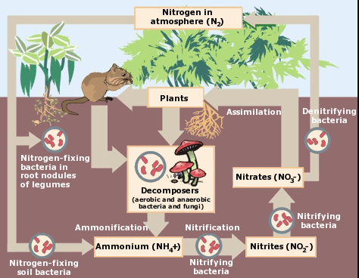
Ammonia (Total, as Nitrogen)
“Ammonia” can be measured in the field or lab as NH₃, NH₄⁺ or both (Total).
Common ammonia sources are sewage and industrial discharges, but it can also be naturally occurring.
Ammonia has a complex chemistry and is part of the “Nitrogen Cycle”.
A typical Action Level for ammonia is 1.0 mg/l.
High pH = more toxic NH₃. Low pH = non-toxic NH₄⁺.
The Oklahoma WQS have no ammonia criteria.
Ammonia also exerts an “oxygen demand” (NBOD).
EPA website on Ammonia: https://www.epa.gov/caddis-vol2/ammonia

Slide 19
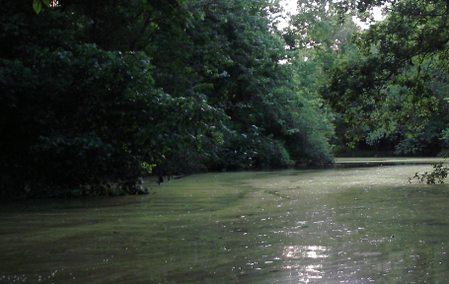
Phosphorus and Nitrogen (Total)
TP and TN field test kits are used to measure nutrients.
P and N chemistry is complex. Some kits measure only one type:
    E.g., Phosphate ions (PO₄⁺) and nitrate ions (NO₃⁻).
The type of nutrient test depends upon your data goals.
TN and TP are good screening tools for nutrients in water.
Excess nutrients indicate stormwater pollution from fertilizers or excess organic materials (natural or manmade).
Interpreting nutrients in water is difficult due to many sources:
    E.g., agriculture and residential fertilizers, ag manure, lawn clippings, illegal dumping, organic and wetland soils, wildlife…
Know the chemistry and environmental effects of TN and TP to help interpret test data.

Slide 20
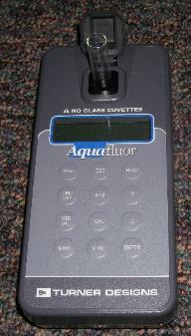
Optical Brighteners (Fluorescence)
Optical brighteners are added to detergents to make cleaned items appear “cleaner” due to fluorescing blue wavelengths of light.
Water samples with O.B.s indicate sewage.
O.B. fluorescence in water samples can be measured by a field fluorometer or absorbant cloths.
O.B.s quickly break down in water, so it is best to use field kits and sample close to the source.
Testing for O.B.s has mixed success; it’s best suited for sampling near sewage spills.

Slide 21
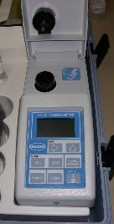
Turbidity (NTU)
A measure of the scattering of light in a water sample from tiny suspended particles. Units are “NTU”.
Turbidity WQS protect the F&WP (numeric criteria) and the Aesthetics (narrative criteria) beneficial uses.
Suspended particles can harm fish (gills) and indicate the presence of excessive sediments (habitat).
Use a visual examination for turbidity to screen for DWFS sources.
Rainfall runoff can trigger periods of high turbidity.
Turbidity WQS only apply to “seasonal base flow” conditions.
Use a field Turbidimeter or collect samples for lab analysis for measuring turbidity.

Slide 22
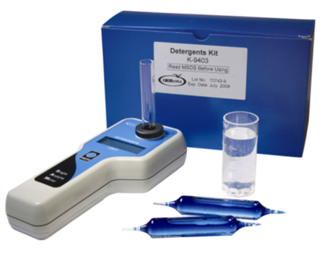
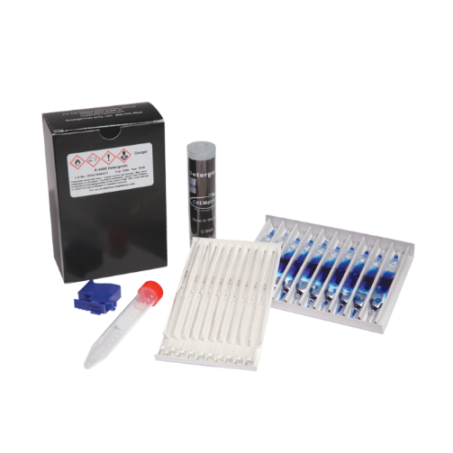
MBAS (Detergents)
MBAS can be determined in the field or lab.
MBAS (Methylene Blue Active Substances) is a test for surfactants used in industrial and residential detergents.
Illicit discharges can contain MBAS from detergents making this a good indicator of sewage and wash water discharges.
Water samples with high MBAS indicate discharges from residential and industrial sources and possibly sewage.
MBAS is not found in natural water or tap water.

Slide 23
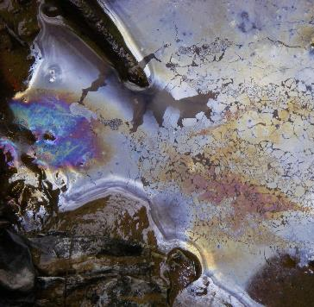
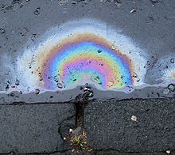
Oil & Grease (Visual)
False O&G
Oil & Grease (O&G) is one of the 303(d) impairment causes.
O&G WQS (narrative only) protect PPWS and F&WP beneficial uses.
Nearly all 303(d) listings are based upon visual observations of the presence of an oil sheen.
There are no O&G field kits; there is a lab test, but it is seldom used.
In the field, visually look for the presence of O&G accumulations and/or its iridescent sheen.
A common mistake is to report O&G presence when the material causing the sheen is a bacterial film.
True O&G
This Photo by Unknown Author is licensed under CC BY-SA

Slide 24
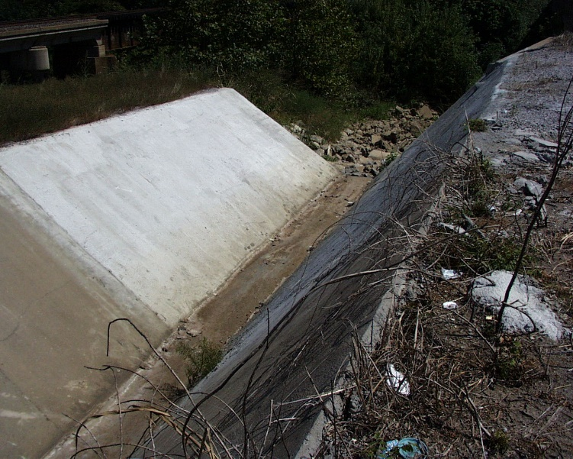
Odors (at Sampling Site)
Not a Test Kit parameter, but very important indicator of pollution or environmental problems.
Odors such as sewage, gas, chemicals or solvents should be noted on field forms.
Sulfides (rotten egg smell) may indicate sewage, industrial discharges or waterbodies with no DO (anoxic).
Rancid or sour odors are commonly traced to food preparation facilities.
Be careful! Many odors indicate presence of toxic, even deadly, chemicals, or are themselves toxic.

Slide 25



Questions ?
Vernon Seaman
Manager, Envir. And Energy Planning
INCOG
Two West 2nd Street, Ste 800
Tulsa, OK 74103
(918) 579-9451
vseaman@incog.org

